Slide 1

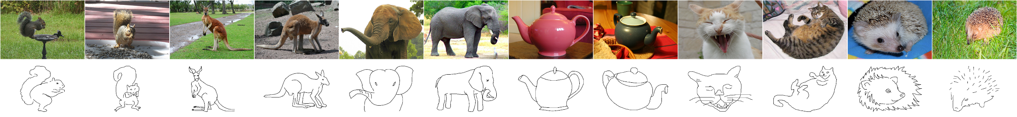


The Sketchy Database
Learning to Retrieve Badly Drawn Bunnies
Patsorn Sangkloy¹ Nathan Burnell² Cusuh Ham¹ James Hays¹
¹
²

Slide 2
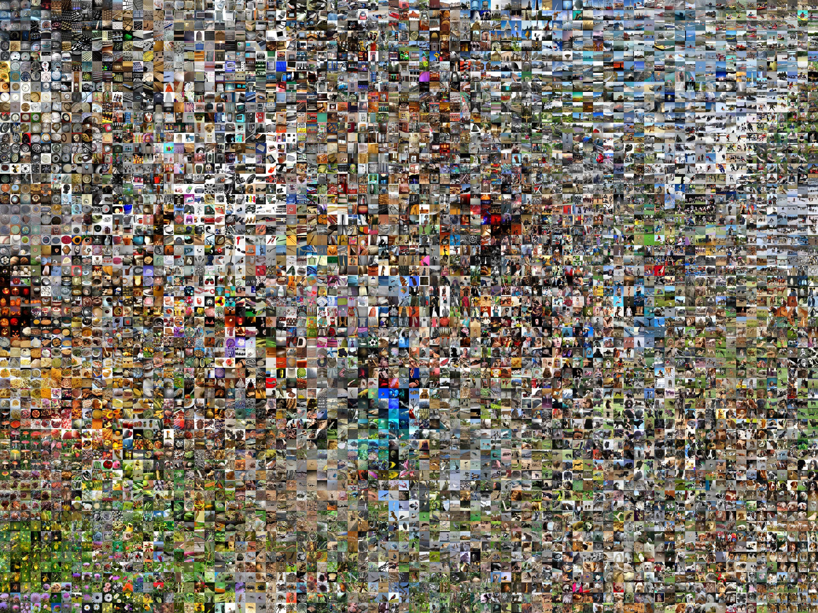
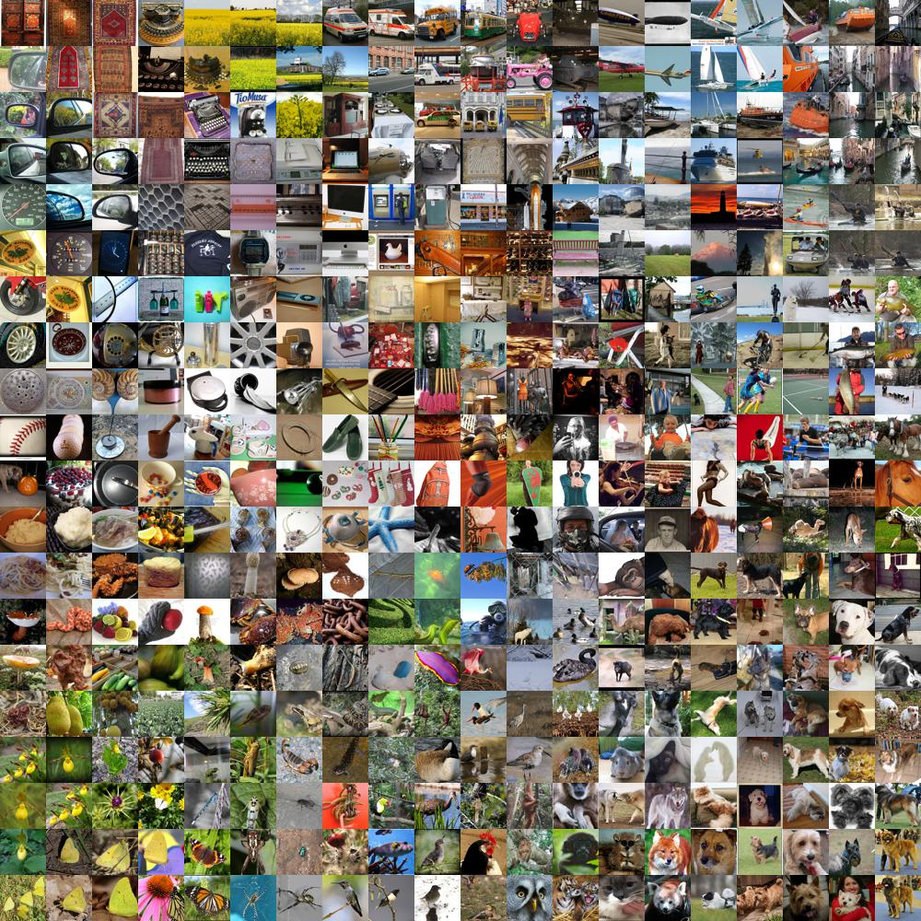
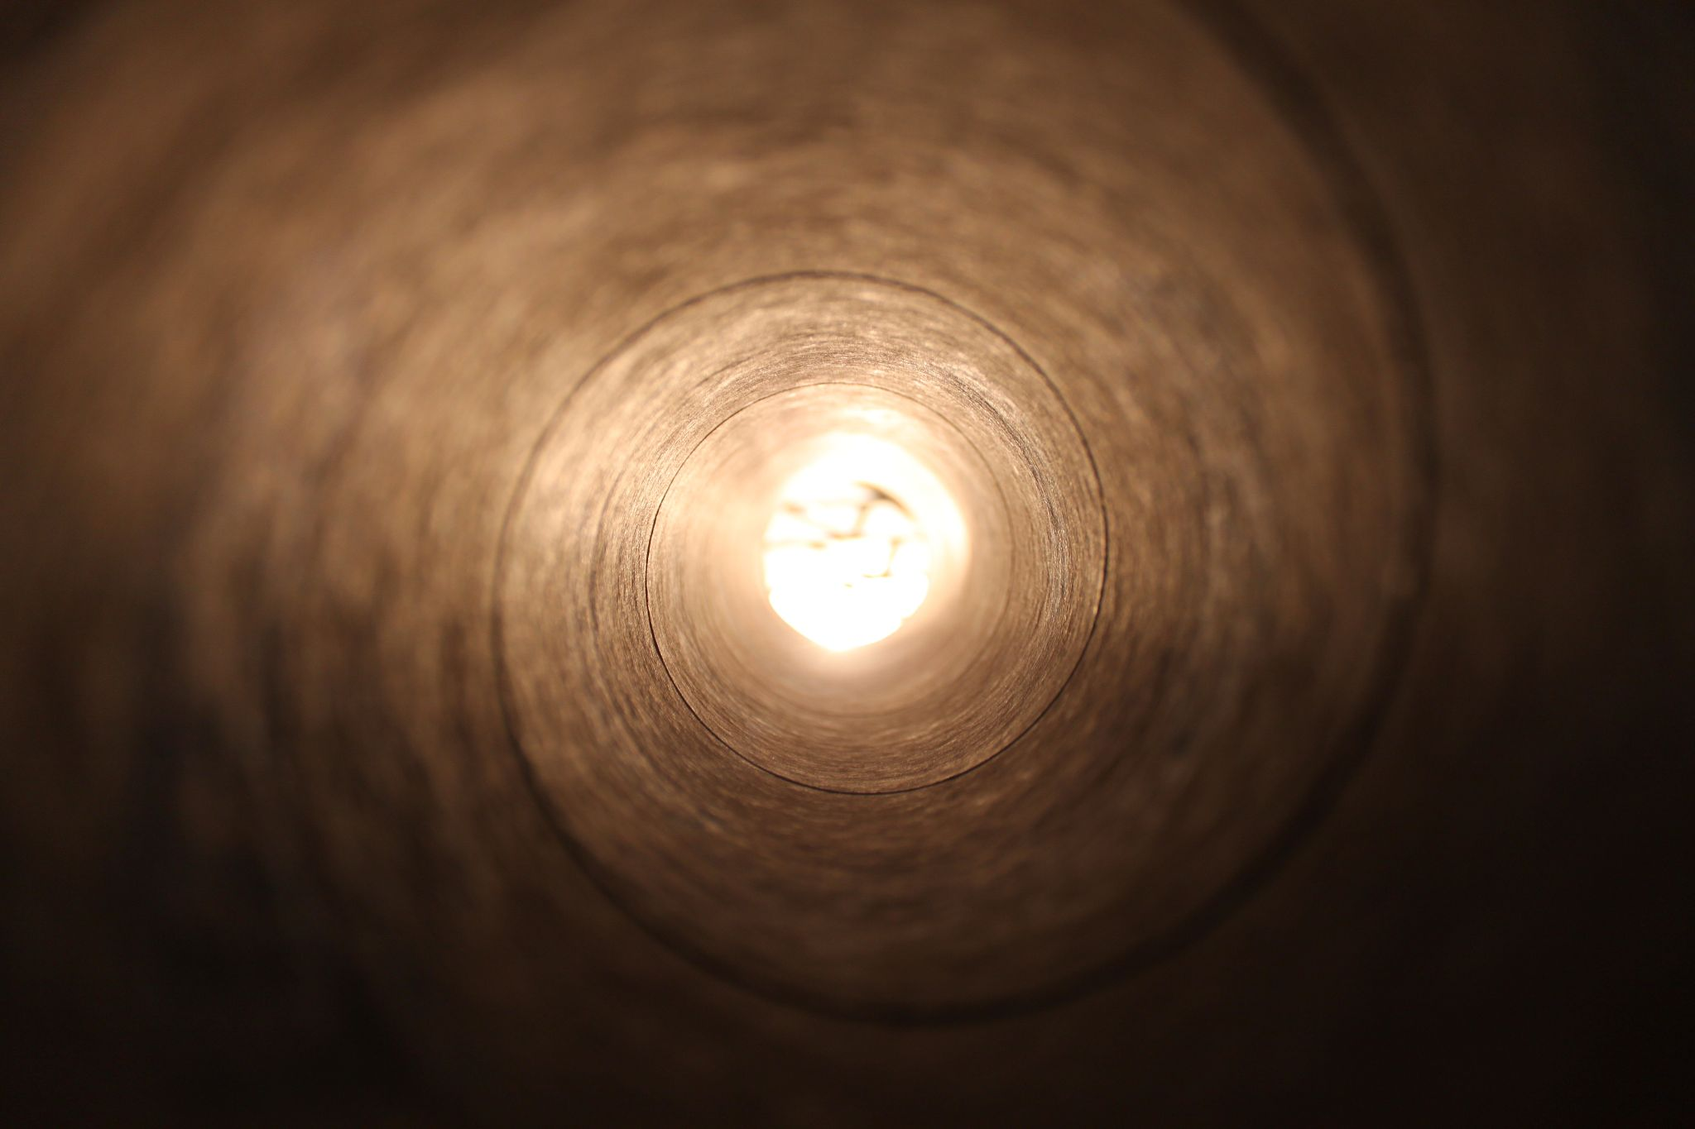
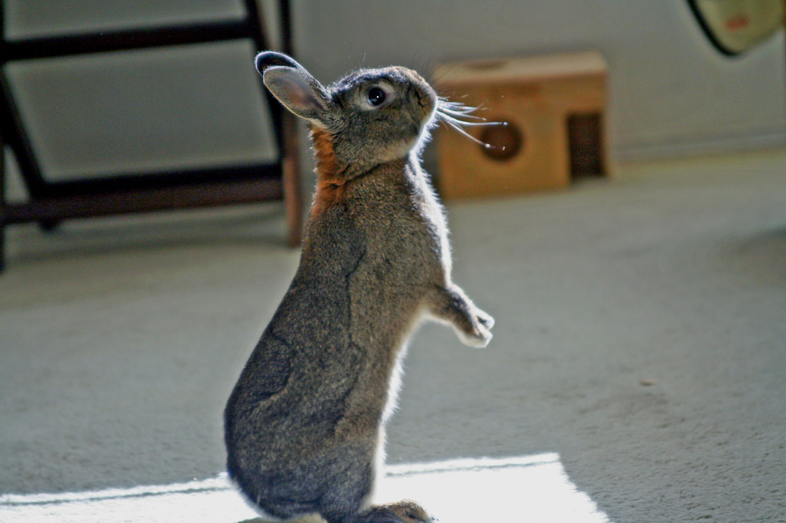
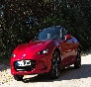
How do you get the image you want?
http://cs.stanford.edu/people/karpathy/cnnembed/
Notes:
With the amount of images we have nowadays, trying to find the one you want can be quite tricky,
[click]
especially when you have something really really specific in mind [click]

Slide 3
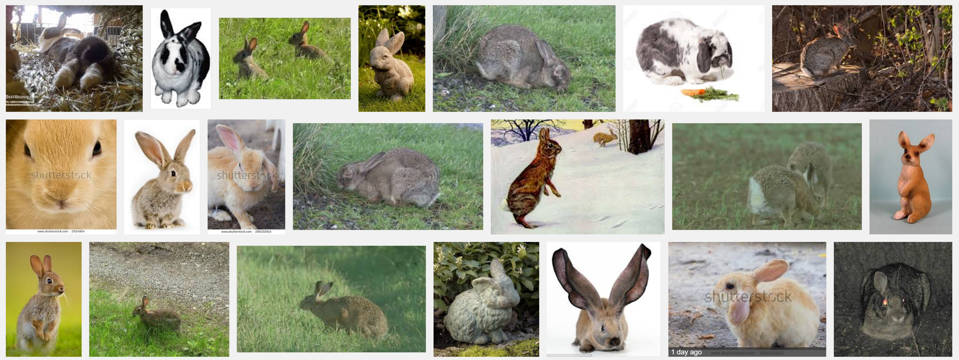
Text search ?
Notes:
In that case, using text description might be difficult. It can be hard to express desired shape, pose, and viewpoint with natural language.

Slide 4

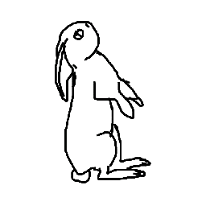


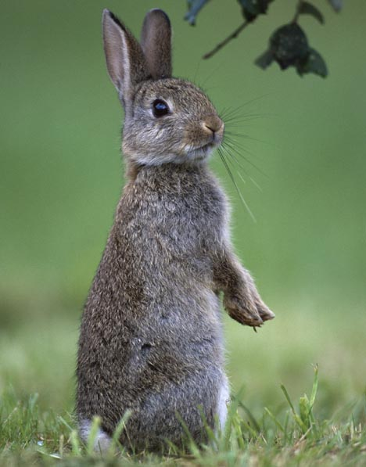
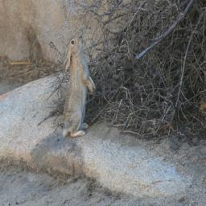
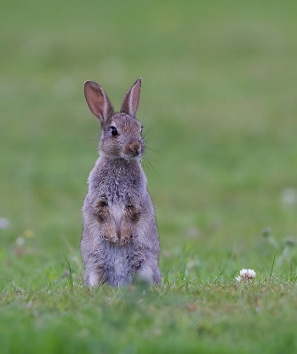
How do humans sketch an object?
Notes:
So instead of using text, a more intuitive approach is to use sketch to describe the image you’re looking for.
The goal here is to retrieve the most similar image, not to the sketch, but to some mental image that prompted the sketch. And in order to decipher what type of image people have in mind when they were sketching, we really have to understand how humans sketch objects in the first place.

Slide 5
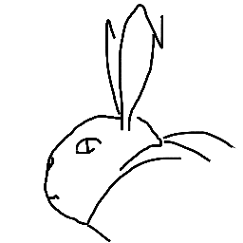
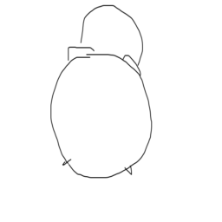
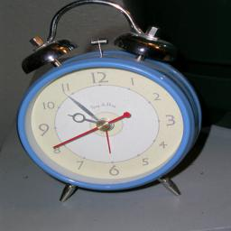
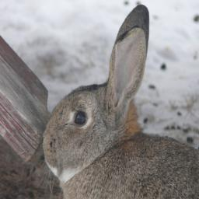
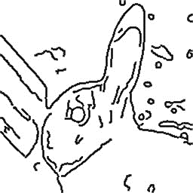
Sketch based Image Retrieval (SBIR)
Previous works:
[Cao et al. 2011; Shrivastava et al. 2011; Cao et al. 2013; Saavedra and Barrios 2015]
Common approach
Sketch query
Matching photo
Human sketch vs Edge detector
Notes:
And the assumption of most prior work is that is that we simply sketch the boundary. So, in general, previous approach to this problem is to, first,

Slide 6
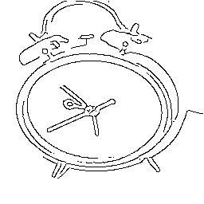
Sketch based Image Retrieval (SBIR)
Previous works:
[Cao et al. 2011; Shrivastava et al. 2011; Cao et al. 2013; Saavedra and Barrios 2015]
Common approach
Perform edge detection on photo
Compare with user sketch
Cons:
Lost information
Human sketch ignore exact boundary, shape
Sketch query
Matching photo
(edge)
Human sketch vs Edge detector
Notes:
convert the photo into pseudo-sketch like version, using edge detection to detect just the boundary of the object. Then compare that to the user sketch. [click]
[click] However, the problem is that a sketch can be quite different than the real world object that it’s referring to. A sketch is much more than a simple tracing of an object boundary.

Slide 7
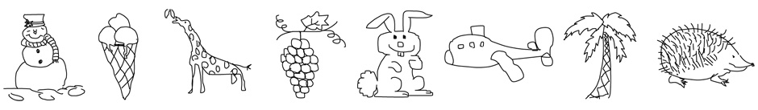
[Eitz et al, 2012]
How do humans sketch an object?
Notes:
There’s a previous work from Eitz et al, that collect large scale dataset of human drawn sketch. This dataset has been used a lot for sketch classification purpose. And it really shows that it’s not just object boundary, when we ask people to draw an object, especially when they have to only rely on their memory, people will do a lot of simplification.

Slide 8
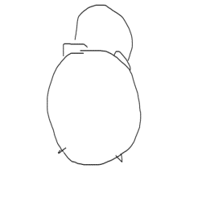
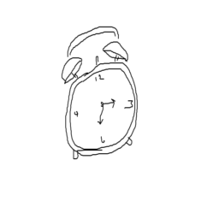
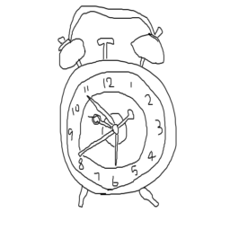
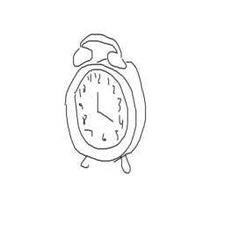
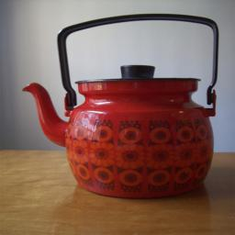
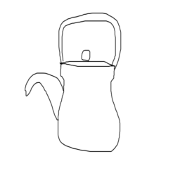
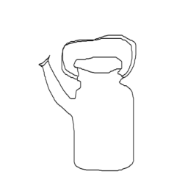
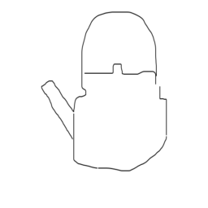
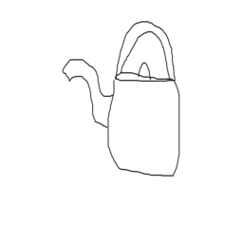
How do humans sketch an object?
Notes:
And this is more evident when we ask people to draw an object from a photo, even though they had just seen it, their sketches still look pretty different than the reference photo. People may not be faithful to the correct perspective, they will even outright change the shape. So it’s very unlikely that the sketched shape and photo boundaries are just going to match.
But still, even though people draw objects differently, I think there’s some agreement on what type of similarity across sketch and photo that is important. Pose and viewpoint are usually what people want to preserve when they are sketching. Shape can be distorted, as long as it’s not completely different. Category is definitely something we don’t want to change when we are sketching something.

Slide 9
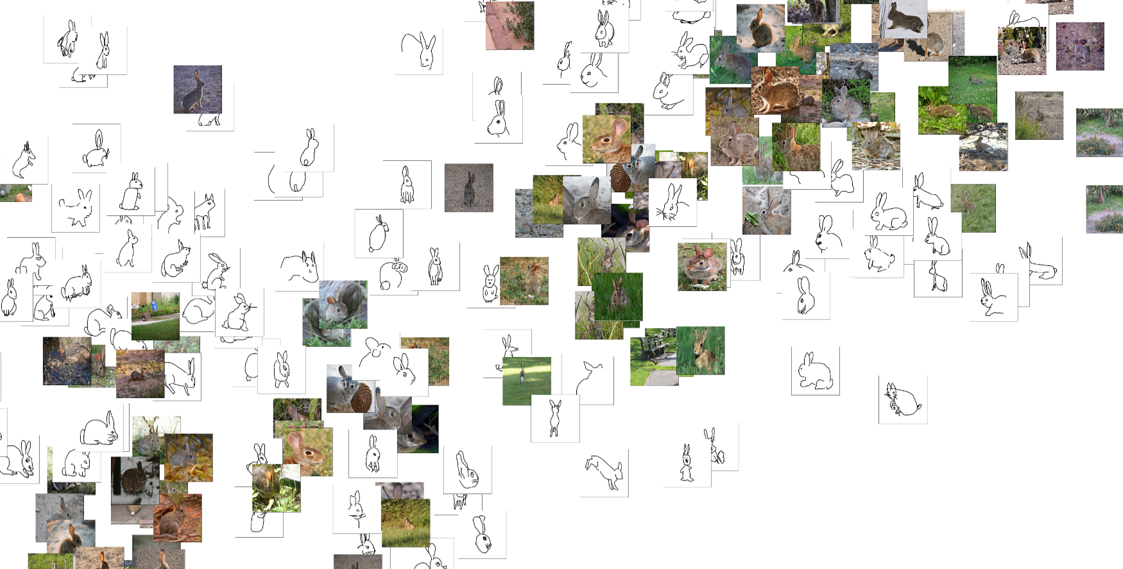
Our approach
Notes:
So what we proposed here, is to train a deep network to learn a share embedding for sketches and photo, such that distances in this learned feature space are related to the type of similarity that make sense to human.
In order to learn those correlation, however, we need data. A lot of sketch/image matching pair that we could use to train our network. So in the next part, Nate will be talking about how we accomplish that.

Slide 10
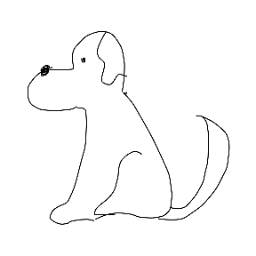
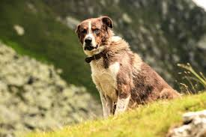
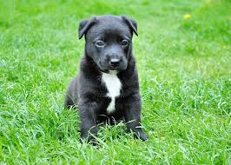
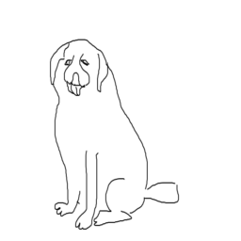
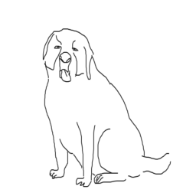
How to Build a Sketch-Photo Dataset?
One approach from Eitz et al. 2011:
Obtain a collection of sketches
Obtain a collection of photographs
Ask participants to match photos to sketches
Our approach:
Obtain a collection of photographs
Ask participants to sketch the contents of each photograph
?
?
Collection of sketch/image pairs
Notes:
Goals:
-- Bottom line: We need a large dataset of sketch/image pairs
-- One option: Match photos to existing sketches
-- Our method: Show a person a photograph of an object and ask them to draw it
-- Why? This will ensure a fine-grained pairing of sketch and photo

Slide 11
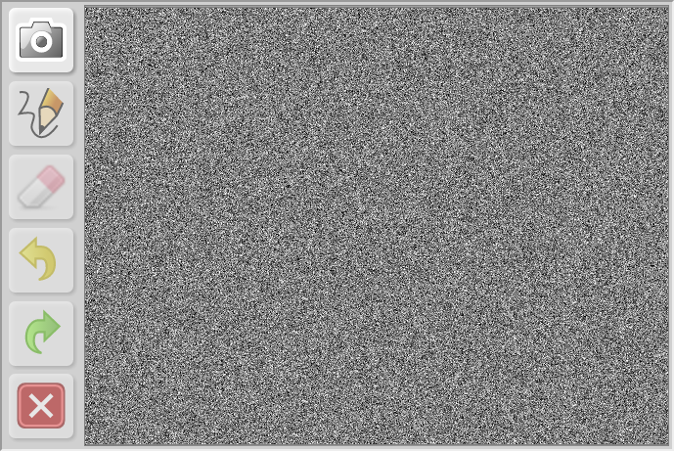
Sketch Collection Interface (1 of 4)
Instructions:
Draw the elephant in the photo!
Do not shade in areas
Capture the elephant’s pose and orientation
Ignore everything in the photo except the elephant
Click the Camera Icon to begin
Collection of sketch/image pairs
Notes:
Script:
I’m going to describe the dataset creation process, starting with the sketch collection interface (shown here).
We utilize Amazon Mechanical Turk – a crowd sourcing marketplace – to recruit hundreds of amateur artists to perform our task.
This means anyone with an Internet connection may grab a phone, tablet, or PC, log in, and contribute sketches to our dataset…and make a little money while they’re at it.
The instructions are fairly simple and we’re going to go through on task together right now.
First, we will show you a photo. In that photo is an elephant. We want you to draw that elephant in roughly the same pose and orientation as it is in the photograph.
You may abstract away fine details and we want you to ignore environmental details – just draw the elephant and nothing more.
Ready to begin?
Goals:
-- Introduce concept of crowd sourcing
-- Introduce the GUI and the collection process
-- Go over the instructions
We want to show the UI first so the audience understands the limitations (and why category and image selection are both important).
-- Initial screen remains as “grey noise” until the user presses the ‘Display Image’ (Camera) button
-- Before allowed to work on these tasks, the workers must pass a qualification test
Notes:
-- UI based on SVG-Edit (highly customized)

Slide 12

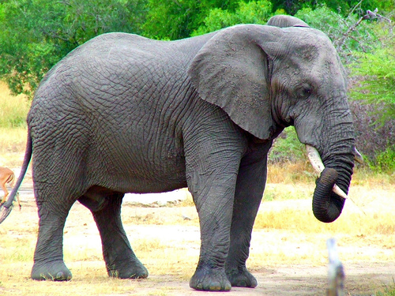
Sketch Collection Interface (2 of 4)
The photo is displayed for 2 seconds…
..and you can’t look at it again without erasing your work!
Collection of sketch/image pairs
Notes:
Script:
You see the photo for 2 seconds…
Goals:
-- Demonstrate the process the workers go through
-- Demonstrate the difficulty of this task
-- Note: This slide should only be displayed for 2 seconds
The idea is to move through these slides in approximately the correct amount of times (e.g., 2 seconds for this slide). If time permits, you may go back to this slide and explain why we only display the subject for so short a period.
We tried a few different exposure times (half a second, 5 seconds, 10 seconds) and found that lower durations produced very poor results and higher durations tended to include scene details. This finding is not published nor is it sound; we chose 2 seconds off what little data we had and the results seem to be a nice balance between pose correctness and scene/subject abstraction.

Slide 13
Sketch Collection Interface (3 of 4)
Then a “grey noise” mask is displayed for 2 seconds…
...which helps discourage rote reproduction or ‘tracing’ of the photograph.
Collection of sketch/image pairs
Notes:
Script:
You see a grey noise mask for 2 seconds…
Goals:
-- Note: This slide should only be displayed for 2 seconds
The idea is to move through these slides in approximately the correct amount of times (e.g., 2 seconds for this slide).

Slide 14


Sketch Collection Interface (4 of 4)
Now, take all the time you need to sketch the elephant.
Tools:
Pencil
Eraser
Undo
Redo
Reset
...we also save timestamps along with vector/curve data.
Collection of sketch/image pairs
Notes:
Script:
And now get to work!
So that probably went by too fast for most of us here. You’re unsure of the composition of the elephant’s legs, trunk, etc., but you recall that it’s an elephant facing right.
This difficulty is deliberate – we want the photograph the inspire the sketch, but we don’t want the sketch to be a rote reproduction of the photograph.
Sketches are inherently diverse and abstract representations of real world concepts.
We want to encourage the crowd to produce these types of sketches, as we feel they are more representative of the types of sketches that will be used to query photographs in a SBIR application.
In fact, if I were to ask all of us to sketch that elephant, I am fairly confident that each and every sketch would be unique.
Yet, despite our differing artistic skill and style, we would likely recognize the majority of these sketches as elephants facing right.
Goals:
-- Discuss the tools available
-- Discuss the quality of the animated sketch (pretty good, quick)
-- Introduce concept of sketch variability (each member of the audience would likely produce a different sketch, yet each one will look something like an elephant facing to the right)
-- Lead in to next slide (capture this property of sketches by asking multiple workers to sketch each photograph)
This artist was pretty good. He or she sketched quickly but managed to capture most of the important details of the subject elephant.
If every one of us in this room were to sketch this same elephant, each and every sketch will be different in some way. Some will be more cartoony. Some will be professional quality and others will be like those of a young child. Even so, most of these sketches will be recognizable as an elephant facing right.
In order to capture this quality of sketches in the Sketchy database, we asked multiple (5 or more) crowd workers to sketch each photograph. Overall, we have over 600 participants of varied skills, input devices, etc.
Note: This is played back at 200% speed

Slide 15

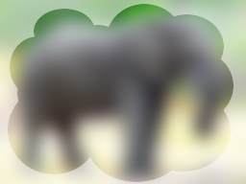

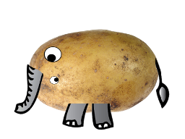
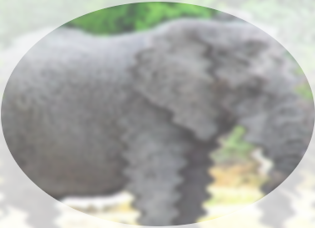

Sketch Diversity
Crowd Worker #1 | Crowd Worker #2 | Crowd Worker #3 | Crowd Worker #4 | Crowd Worker #5
Collection of sketch/image pairs
Notes:
Script:
In order to capture this property of sketches in our dataset, we ask multiple crowd workers to sketch each photograph.
As you can see here, some workers are faster, some slower, some produce accurate reproductions while others produce more abstract, cartoony reproductions.
And, unfortunately, some produce nightmare-inducing potato-elephant mutants.
Goals:
-- Discuss the differences in each worker’s skill, speed, and perception
-- Introduce the concept of incorrectness
Each crowd worker has a different skill level and different perception [memory or recall] of the photograph…
Some are faster, some slower
Some have artistic skill and/or experience
Some attempt to reproduce the subject faithfully
Some abstract away details and create crude/cartoony sketches
Some see mutant potato creatures
Some don’t quite follow the rules

Slide 16
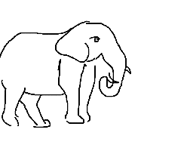
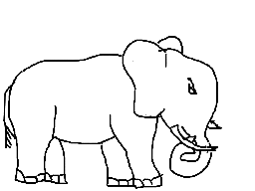
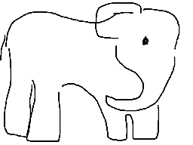
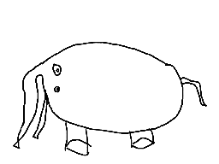
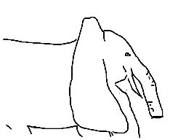


Sketch Review
Crowd Worker #1 | Crowd Worker #2 | Crowd Worker #3 | Crowd Worker #4 | Crowd Worker #5
Good!
Good!
Good!
Mirrored!
Incomplete!
Potato!
Collection of sketch/image pairs
Notes:
Script:
And for that reason, we must introduce a review process.
We manually review all the sketches and annotate those that are incorrect in some way.
We do not consider sketch quality unless a sketch is so poor that it’s subject is ambiguous and/or one or more rules were not followed.
These sketches remain in the dataset with annotations; depending on the goal, some training tasks may find use for some of this data.
Still, we issue new AMT tasks and gather sketches to replace those that were deemed incorrect.
The goal is to have 5 correct sketches per photograph.
Goals:
-- Discuss the review and “incorrectness” annotation process
-- Discuss the gathering of replacement sketches
Not all sketches are correct, so we manually review and annotate each sketch. Further sketches are collected to replace ‘bad’ sketches.
Sketches are judged based on:
-- Ambiguity: Is it reasonable to believe another person would correctly identify the subject of the sketch?
-- Pose/Perspective: Is it reasonable to believe another person would believe that this sketch was inspired by the photo?
-- Context (and general rules following): Did the artist include photo content that is unrelated to the subject and/or occlusions?
-- Error: For those sketches that are extra wrong...
Note: Sketches are rarely discarded due to poor artistic skill.

Slide 17
Category Selection
Eitz Dataset (SIGGRAPH 2012)
250 Categories
Category Selection:
Exhaustive
Recognizable
Specific
Includes “part of” relationships
and “action” descriptors
ImageNet (CVPR 2009)
20k+ categories
Category Selection:
WordNet Ontology
Internet image search
Includes “is a” relationships
(hierarchical)
Category Selection
Notes:
Script:
Now that we understand how the data was collected, I want to briefly discuss the category and photograph selection process.
A natural starting point is the 250 categories used by Eitz 2012.
And we turn to the ImageNet dataset for photographs.
ImageNet is very large and contains bounding box annotations in most common categories.
These bounding boxes are important to us because they allow us to exclude images with multiple object instances.
Also, the bounding boxes are important to any task that requires a strong spatial correspondence between the sketch and photo – the sketch may be rendered within the object bounds in photo space.
Goals:
-- Category selection is surprisingly difficult
-- For sketches, we want to be compatible with Eitz 2012
-- Eitz used three criteria for category selection
-- For photos, we choose ImageNet due to its size and exhaustive category coverage
-- ImageNet uses image searches and a hierarchical structure
The Eitz criteria: Covers many common object types (exhaustive), recognizable (objects that have distinctive sketch representations), and specific (limit the number of object ‘modes’ and visual variation). Because this is drawing from your imagination, mythological and fantastical categories are included. The ‘Specific’ criterion sometimes includes actions/states, such as “flying bird” Vs. “standing bird”.
The ImageNet criteria: Inherited from WordNet, which is a tree-like structure with ‘is-a’ relationships. For example (notional), a German Sheppard is a Working Dog, which is a Canine, which is a Mammal (etc.). Parts of wholes (e.g., eye, mouth, arm) are not typically included as categories nor are action/state

Slide 18
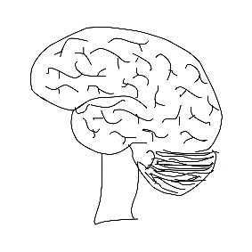
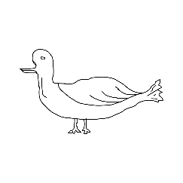

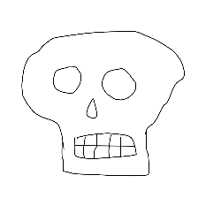
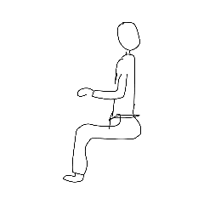
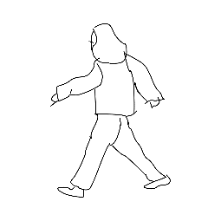
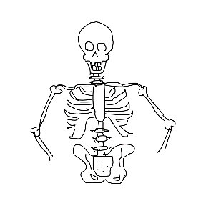
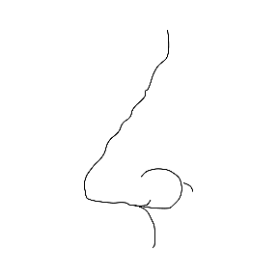






Eitz 2012 – Imagination Vs. Reality
“Unsettling”
Brain
Skeleton
Skull
Body Parts
Arm
Ear
Mouth
Action Qualifiers
Flying Bird
Standing Bird
Person Sitting
Fantastical
Angel
Flying Saucer
Mermaid
Category Selection
Notes:
Script:
For the Eitz 2012 dataset, workers were prompted to sketch with a category label, so they sketched from their own imaginations.
For our dataset, we are using real images – and real images can be gory (in the case of brains and skulls) or impossible (in the case of dragons and mermaids).
Goals:
-- Convey the difference between drawing from your imagination and from photographs
While artists used their imagination to create the sketches in Eitz 2012, we wish to prompt sketches with photographs.
We can sketch cartoony and abstract skulls and brains with ease, but the photographs are unpleasant. Likewise for body parts, like arms and ears. ImageNet was created with Internet image searches, so sometimes the content is inappropriate or disturbing.

Slide 19


Challenges with Internet Photos (1 of 3)
Electric refrigerator, fridge
Category Selection
Notes:
Script:
ImageNet is comprised of photos obtained via Internet searches.
There are several properties of Internet images that we had to wrestle with.
First, people don’t tend to take photos of mundane objects in mundane circumstances.
For example, most photos of refrigerators are not what you’d imagine if someone said ‘sketch me a refrigerator’.
Instead, the photos are refrigerators covered with magnets, stuffed with bear, or filled with cats.
Because of the prevalence of these types of photographs, some categories were ruled out.
Goals:
-- Discuss the “mundane photographs are rare” phenomenon
There are several challenges with ImageNet categories. For relatively mundane object categories (e.g., “refrigerator”), people tend to take unusual photographs (e.g., refrigerators loaded with beer, refrigerators covered in magnets, refrigerators with cats sitting in them, etc.). Otherwise, the images are advertisements with low quality and edits. Very few “good” examples exist in some categories.

Slide 20


Challenges with Internet Photos (2 of 3)
Bicycle, bike, wheel, cycle
ImageNet is built from Internet searches…
“Bicycle” has a fair number of photographs from a certain bicycle race in Seattle.
“Armor” has an absurd number of photographs of a DJ/mascot.
House centipedes are scary.
…and the Internet is a strange place.
Photo Selection
Notes:
Script:
Not too surprisingly, another issue we ran into is inappropriate or strange content.
For example, the bicycle category contains a fair number of photographs from the nude bike race in Seattle.
So it’s becoming more evident to us that we will have to review the photographs rather than automate the selection process.
Goals:
-- Images gathered from Internet searches tend to be unusual and/or strange
-- Inappropriate: Nude bicycle races
-- Unexpected: Odd, spandex-clad mascots
-- Unpleasant: Scary close-ups of bugs
-- We want this to be fun for the workers since the pay is not great
Anecdotes on what makes photo category (and photo example) selection difficult.

Slide 21






Challenges with Internet Photos (3 of 3)
Artistic and Macro Photos
Many photographs are nearly impossible to sketch in meaningful ways.
Photographers take ‘artsy’ shots of horses, instruments, etc.
Food items have very different modes
Review 69.5k photographs, deem 35% as suitable for our dataset
Crocodilian
Guitar
Horse
Apple
Crab
Strawberry
Photo Selection
Notes:
Script:
Finally, photographs can be very informative to us, even if they are zoomed-in patches of texture or distinctive parts of animals.
However, these photographs would be much less meaningful when interpreted as simple sketches.
We decide to review all photographs in all categories under consideration.
Goals:
-- Photos are not always easy to draw in a meaningful way
-- Objects that are also food items have multiple modes
-- Most photographs are rejected

Slide 22

Photograph Review
Photo “Sketchability”
We judge each photograph for “sketchability” (scale 1-6)
We favor “easy” photographs
Highly subjective
Photo Quality Constraints
Photo resolution
No/minimal digital editing
Only one subject example
Photo Selection
Notes:
Script:
In doing so, we come up with the concept of “sketchability”.
We judge each photograph based on how easily we believe an amateur artist can capture the object pose and identity.
In the diagram here on the far left are easy-to-sketch photos, while the far right shows some impossible-to-sketch photos.
Goals:
-- Each photo was judged for “sketchability”
-- Each photo was judged for “quality”
Manually review photographs for “sketchability”, a new criterion we apply to both photograph and category selection. Real world photographs are much messier than what we can imagine in our heads.
In addition, we reject photographs of poor quality and/or undesirable traits (such as photo editing effects/augmentations).

Slide 23
Category Selection Summary
DELETE THIS SLIDE
Sketchy DB
125 Categories
Eitz 2012
250 Categories
ImageNet
20k+ Categories
Collection of sketch/image pairs

Slide 24








Sketchy Database - Summary
Sketchy Database – Information
Notes:
Goals:
-- Summary of the dataset

Slide 25
Sketchy Database - Summary
125 categories
Compatible with Eitz 2012
12,500 photos (100/category)
ImageNet photographs
Bounding box annotations
Single subject object
Quality controlled
“Sketchability” annotations
75,471 sketches
At least 5 “good” per photo
Crowd-sourced (600+ workers)
Varied artistic skill
Varied perceptions
Correct/incorrect annotations
“Along the stroke” relative time information captured
SVG and PNG formats
Project page (downloads available): http://sketchy.eye.gatech.edu
Sketchy Database – Information
Notes:
Goals:
-- Summary of the dataset

Slide 26
Image matching with Deep Learning
Notes:
In this part, we’ll be talking about using what we collected earlier, to train a deep network. Recall that our goal is to learn the mapping functions that will map both sketch and photo into a shared embedding space that is comparable.
And there’s a specific type of network, that has been used to accomplish similar task. Its called Siamese network

Slide 27
Siamese/Triplet network
Compare
Previous works:
Feature
Feature
Matching across similar domain
DeepFace –[Taigman et al. 2014]
Product Search – [Bell and Bala 2015]
Matching cross domain
Sketch/3d model- [Wang et al. 2015]
Sketch me that shoe - [Yu et al. 2016].
Learned Weights
Learning similarity metric
Notes:
A siamese network is a type of deep neural network, consist of two subnetworks, usually this is identical. We do that by sharing weight between networks, forcing the learned parameters to be the same on both side
So this type of network, and also one of their variation, triplet network, has been used successfully in a lot of image matching problem.
[click]

Slide 28

Siamese/Triplet network
Compare
Previous works:
Feature
Feature
Matching across similar domain
DeepFace –[Taigman et al. 2014]
Product Search – [Bell and Bala 2015]
Matching cross domain
Sketch/3d model- [Wang et al. 2015]
Sketch me that shoe - [Yu et al. 2016].
Learned Weights
Learning similarity metric
Notes:
Such as matching between face asking whether the two face belong to the same person

Slide 29


Siamese/Triplet network
Compare
Previous works:
Feature
Feature
Matching across similar domain
DeepFace –[Taigman et al. 2014]
Product Search – [Bell and Bala 2015]
Matching cross domain
Sketch/3d model- [Wang et al. 2015]
Sketch me that shoe - [Yu et al. 2016]
Learned Weights
Learning similarity metric
Notes:
Or matching between iconic product image, and a cropped image of that product in a real world setting.

Slide 30

Siamese/Triplet network
Compare
Previous works:
Feature
Feature
Matching across similar domain
DeepFace –[Taigman et al. 2014]
Product Search – [Bell and Bala 2015]
Matching cross domain
Sketch/3d model- [Wang et al. 2015]
Sketch me that shoe - [Yu et al. 2016]
Learned Weights
Learning similarity metric
Notes:
More related to our problem, is the concurrent work at queen mary university, sketch me that shoe, which has just been present at cvpr last month actually. They explore similar setting of matching sketch and image, but focusing more on fine grain matching within the same category.

Slide 31
Siamese/Triplet network
Compare
When to share weight?:
Feature
Feature
Inputs in the same or slightly different domain
Learned Weights
Learning similarity metric
Notes:
In general, sharing weight in Siamese network is pretty common when the two inputs are expected to be somewhat similar, such as both being photo. Or both being sketches. or for cross domain between sketch and photo, you could also do edge detection on the photo first, so that both of the input will sort of be in the same domain. This is a pretty common approach when apply Siamese network to a cross domain input.

Slide 32


Siamese/Triplet network
Compare
When to NOT share weight?
Feature
Feature
Inputs in different domains
Have enough data to avoid overfitting
Learned Weights
Learned Weights
Learning similarity metric
Notes:
But in our case, since we want to compare sketch to the photo directly, instead of sharing weight parameters across the two subnetwork, what we can do is let them learn those separately.
Now, as you can imagine, without sharing weight, we have a lot more parameters to learn, so we would need a lot of data to avoid overfitting. And this is where our sketchy dataset comes in. We have a large collection of sketch and image pair that we can use for the training.

Slide 33
Sketchy database as a training data
Compare
Feature
Feature
Learned Weights
Learned Weights
Rasterize vector sketch
Notes:
One thing to note is that, although our data have all those temporal information about user stoke, we didn’t make use of those fine grain timing, and simply rasterized them for the training purpose.

Slide 34




Sketchy database as a training data
Normalize sketch
Notes:
We also normalize the sketch by uniformly scale and center them.

Slide 35


Sketchy database as a training data
Normalize sketch
Notes:
So that the network would learn to be invariance to scale and location, which is what we assume user would want when they are using sketch based image retrieval system.
They would care more about matching pose, or viewpoint, and other attribute, rather than the exact location and scale.

Slide 36
Cross domain Siamese Network
Photo Net
Sketch Net
Feature
Feature
Compare and
Adjust
Learned Weights
Learned Weights
forward -> compute loss -> backprop -> update weights
Notes:
So, in our case, it works like this, when we feed our inputs, both sketch and photo, through the network [click].
Then, we’ll get some feature representation as output.[click]
At this point, we will have some loss function[click] that determine the relation between these two features[feet]. [click]
From there[click] we back propagate the error, and
adjust the parameters [click] such that those error will be reduce, step by step.

Slide 37
Embedding Loss
Siamese Network - Contrastive Loss
L = c ∗ d(S, I+) + (1 − c) ∗ max(0, m − d(S, I−))
Triplet Network - Ranking Loss
L = max(0, m + d(S, I+)−d(S, I−))
Output feature space
Output feature space
m
S sketch query
I+ matching image
I- non-matching image
m Margin
c 1 for positive pair
0 for negative pair
m
Positive pair
Negative pair
Siamese Input: or
Triplet Input:
Pull positive pair/Push negative pair
Notes:
So let’s talk about the loss function
In siamese network originally it was introduce with contrastive loss. Taking either positive or negative pair. And if it’s positive, meaning the sketch and image match, then their distant need to be zero in order to avoid any penalty [click] while for negative pair, [click] it need to be larger than some margin.
There’s also another variation of Siamese network, called triplet network. The different between these two is mainly in how we compute the loss, and in turn how we sample the training data to compute such loss. The key ideas in the ranking loss is that, we only want the distant between negative pair to be larger than positive pair, by at least some margin m. [Click]
And this allow us more control over the level of similarity. Because now the distant are relative, instead of absolute.
So, these embedding loss are trying to pull the similar image and sketch closer, and push the rest away in this output feature space

Slide 38
Photo Net
Sketch Net
Feature
Feature
Rabbit
Compare and
Adjust
Rabbit
Learned Weights
Learned Weights
Classification Loss + Embedding Loss
Notes:
But only embedding loss might not be enough. Our space is pretty large, the data we collected has over 125 categories, so to help encourage the network to learn discriminative feature that can also differentiate between different category, we also add classification loss to both subnetwork. [click]
This loss acts as a guidance to help the network arrange this feature space in a way that correspond to how human look at similarity, since we usually consider same category to be more similar semantically.
So this will be the architecture that we’ll be using.

Slide 39


AlexNet Model
[Krizhevsky et al. 2012]
[Hu et al. 2015]
GoogleNet Model
[Christian et al. 2015]
Fine tuning the network
Notes:
Now, for the training,
In training deep network, it is quite common to ‘steal’ what other network has learn, by copying over their learned parameters, and use that as a starting point. So we did the same, we fine tune from network that was trained using a very large ImageNet dataset. We experiment with two of the architecture, the widely used AlexNet model, and a much deeper googlenet model.

Slide 40


Photo Net
Sketch Net
Pre-trained ImageNet classification network
Pre-trained ImageNet classification network
Classification task on the Eitz 2012 sketch dataset
Classification task on our sketchy dataset
Classification task on our sketchy dataset
Embedding + classification task on our sketchy dataset
Notes:
So we start with this pre-train imagenet network.
And for the sketch branch, we also further fine tune the sketch network, by continue the training using a the sketch dataset from eitz et al.
After that, we train with our sketchy dataset, first for classification task, then we add the embedding loss

Slide 41
Bunny War!
Notes:
So in the end, semantically similar object will hopefully be placed closer together in this feature space. And here we apply TSNE visualization technique to project our feature representation of both sketch and photo into 2 dimension. So what you see here is not the exact distant, this is for visualization purpose. Still, we can see that it’s recognize different pose in both sketch and photo, [click]
like facing right,
[click] facing left, and
[click] there’re frontal view

Slide 42


TSNE Visualization
Notes:
Now that was for only one category, we can also plot the TSNE visualization of all the category, and we can zoom in on some part. [click] Here you can see that some semantically similar category, are mixing together in this feature space. Like horse and giraffe got place closer here, even though we didn’t explicitly have that sort of information in the training data. The network learn the relation them self.

Slide 43

TSNE Visualization
Notes:
Or on the other corner we would have some sort of instrument, that looks visually similar.

Slide 44



















Photo Net
1. Extract feature for images
Notes:
But then how do we do sketch based image retrieval?
Now, the cool thing is that, after we finish training the network, we can just use each network separately. So we can first [click] extract feature for image, and you don’t have to do that again as long as your images stay the same.

Slide 45

Sketch Net
2. Extract feature for query
3. Find the nearest matches!
Notes:
And then when we get new sketch input, we can use sketch network to extract feature. Then we can simply use Euclidean distant and find the nearest image.

Slide 46


















Which is better?
How do we evaluate?
Notes:
But How do we evaluate though? It can be quite ambiguous and subjective which one is better.
But in our sketchy dataset, we know that there exist some image that prompt the sketch, so we know for sure that there’s exist a match. [click]
So what we can do is to evaluate their ability to retrieve that target image by measuring recall value. But since we only have 1 target image, it will be either 1 or 0, true of false. For whether the network can retrieve the target image with in k results. We can measure this for any value of k,

Slide 47
Which is better?
Recall@5
How do we evaluate?
Notes:
For example if k=5, every one of these results would be corrected, and be 1.

Slide 48
Which is better?
Recall@1
How do we evaluate?
Notes:
but the more interesting is when k=1. That correspond to the first retrieval results, so we are asking if the first result is the right one. And that would mean only the second row has recall would be correct and have value of 1, while the rest are 0. So for this tiny testset example, the total recall would be one third if we average over it.
So with this we withheld 10% of our data for just for the testing, and we can just averaging over all of them and plot recall at k.

Slide 49

Recall@1
Human benchmark
Notes:
Finding the single best matching photo out of more than a thousand photos in the test set is quite difficult, even for humans. To evaluate human performance we present random sketches and ask them to pick the target among 1250 test photos arranged by category. And on average, people only make the right guess 54% of the time. Although the accuracy varies a lot between participants with some getting higher than 70%, some less than 10%.

Slide 50
Recall@1
Our results
Notes:
Still, our approach works pretty well here. Our best performing network, triplet network using GoogleNet model, achieves 37%, meaning it can guess the right image 37% of the time. Which is not too bad. And all other variations achieve higher than 20%.

Slide 51
Recall@1
Notes:
We also evaluate on a couple of our own baselines, I don’t really have time to go into details here, you can find out more about it in our paper.

Slide 52
Recall@1
[Eitz et al. 2012b].
Gabor local line based feature [Eitz et al. 2012]
Notes:
We also benchmarked several low level features which compare sketches to edge-detected photos and the GALIF feature was the best performer, but still far below our approaches.

Slide 53
Recall@1
Random guess?
Notes:
And also, another thing I want to point out is that, with the amount of images we have in the test set, it is practically impossible to just randomly guess the right one.
In any case, these number alone are pretty difficult to see what it really means.

Slide 54

Notes:
So lets look at the qualitative results.
Here we downloaded more than 400 thousand photos, from flickr, that’s never been seen in the training data. And we picked sketch query from our test set we withheld, which again, has never been seen by the network.
Still, the network seems to understand the general ideas, such as category, post, or viewpoint, that user express via the sketch, and able to retrieve similar image based on that.

Slide 55
Notes:
But, I still think there’s a lot of room for improvement, in term of making it more fine grain. More faithful toward the sketch post and shape. So we really hope that, with the release of our sketchy dataset, it will make it easier for people looking into this problem, to learn from our data and to evaluate their approach on our benchmark.

Slide 56

http://sketchy.eye.gatech.edu/
Thank you!
Notes:
I’ll end with a video of an application we implemented based on our approach. We also have an online demo on our website, so you could try it out

